Slide 1
Java Reader class
Reader class is an abstract class for reading character streams.
A Reader is like an InputStream except that it is character based rather than byte based. In other words, a Java Reader is intended for reading text, whereas an InputStream is intended for reading raw bytes.
Reader
BufferedReader
CharArrayReader
FilterReader
InputStreamReader
PipedReader
StringReader

Slide 2
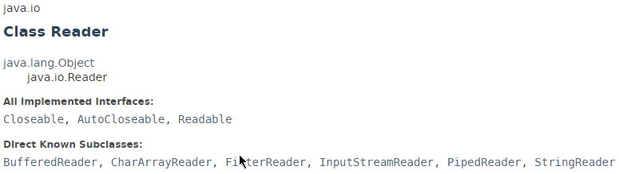
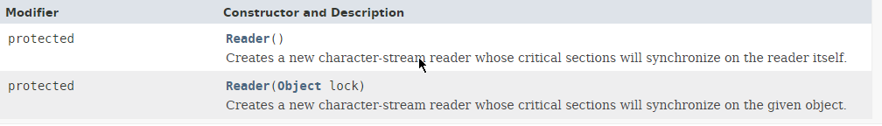
Java Reader class

Slide 3
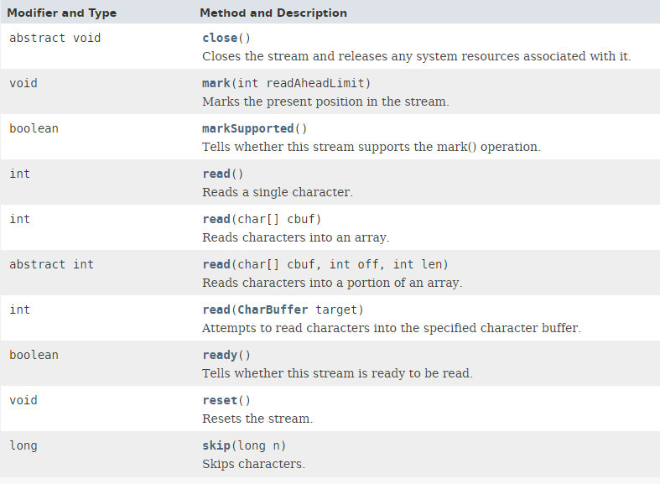
Java Reader class

Slide 4
Java Reader class
https://docs.oracle.com/javase/8/docs/api/index.html?java/io/Reader.html

